Slide 1

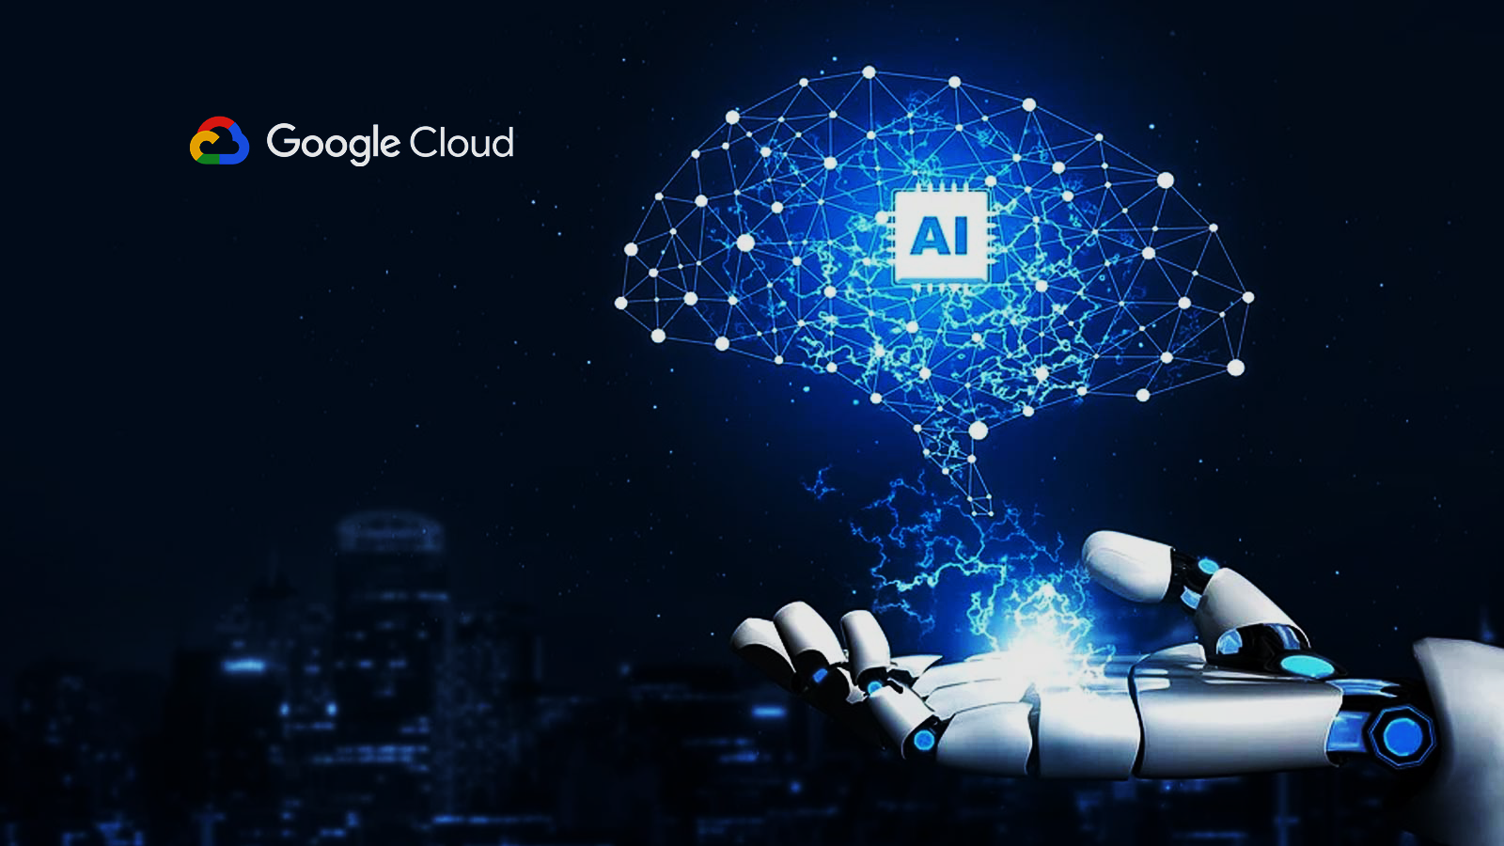
Google Cloud AutoML vs Custom Training using TensorFlow
Leidenschaft fürs Leben.
Ketan Darekar
Cris Kohn
Gayatri Samal
Vipul Zope

Slide 2
Table of contents
01
Introduction
02
Overview of AutoML
03
Overview of Custom Training
04
Comparison
05
Conclusion
06
Prototype

Slide 3
Tasks Division
Gayatri Samal Cris Kohn
Ketan Darekar Vipul Zope
Google Cloud AutoML
Custom Training
Comparison

Slide 4
Introduction
01

Slide 5
Introduction
This is a comparison of Google AutoML and Custom Training for automating machine learning workflows.​
AutoML and Custom Training are two popular approaches for developing machine learning models in the Google Cloud AI platform.​
Custom training in Google Cloud refers to the process of training machine learning models using any machine learning framework on Google Cloud infrastructure.​
AutoML is the product offered by google cloud which help developers with less expertise to build complex and custom high quality ML models.​

Slide 6
Introduction to Vertex AI
Vertex AI is a machine learning platform that lets you train and deploy ML models and AI applications.
It combines data engineering, data science, and ML engineering workflows.
Hence, enabling your teams to collaborate using a common toolset.
Vertex AI provides several tools for model training and serving.

Slide 7
Tools Of VertexAI
AutoML
Custom Training
Model Garden
Generative AI

Slide 8
Overview of AutoML
02

Slide 9
AutoML
AutoML uses automated algorithms to streamline the process of building, training, and deploying machine learning models.
It allows you to train tabular, image, text, or video data without writing code or preparing data splits.
It offers a simpler and faster approach for non-experts to build models without extensive coding and programming knowledge.
Google Cloud AutoML is a suite of machine learning products and services offered by Google Cloud Platform (GCP) that allows users to create custom machine learning models without requiring extensive knowledge of machine learning

Slide 10
With AutoML Vision, users can train custom image recognition models using their own images, without needing to write any code.
AutoML also includes natural language processing (NLP) capabilities. AutoML Natural Language allows users to train custom models for tasks such as sentiment analysis, entity recognition, and content classification.
You have a bunch of pictures of Adidas and Nike shoes, and you want to distinguish whether they are Nike or Adidas. You should apply machine learning techniques to train your data and recognize which brand they belong to -> Auto ML

Slide 11
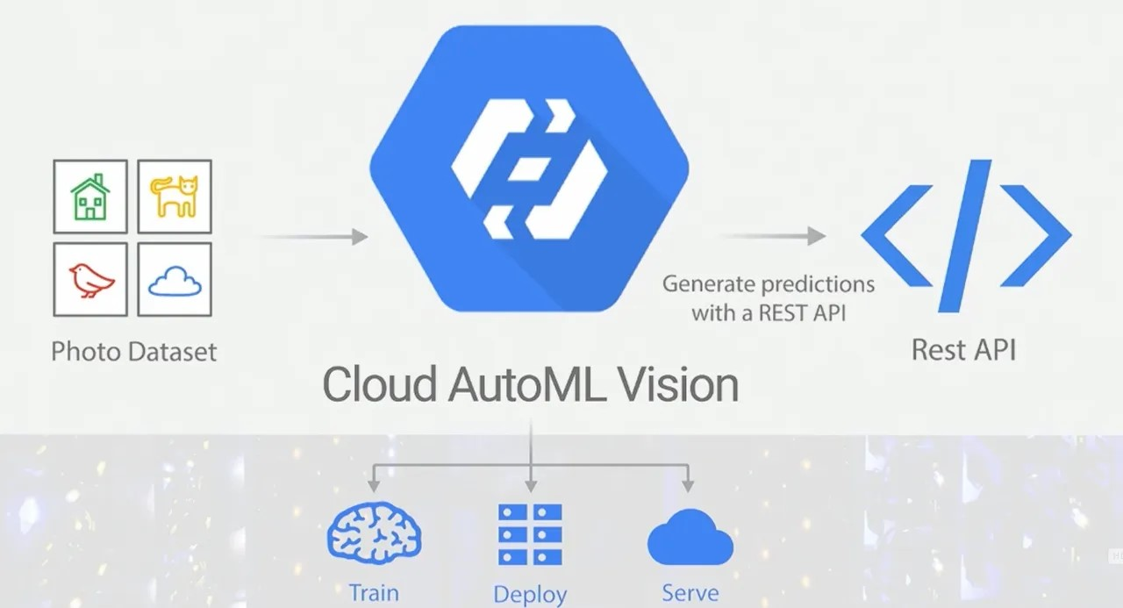
Overview of how AutoML works

Slide 12
AutoML Workflow for Image Classification
Data Acquisition
Data Pre-processiong
Data Connecting
Data Engineering
Data Modelling
Hyerparameter Tunning

Slide 13
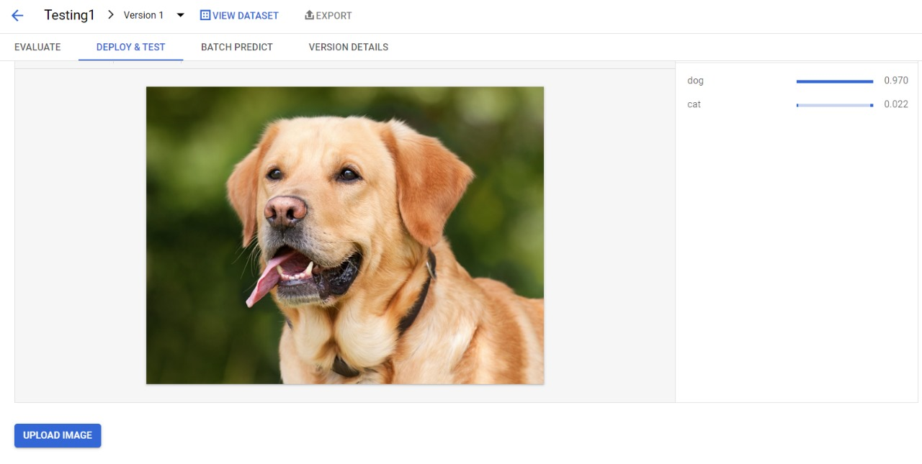
AutoML

Slide 14
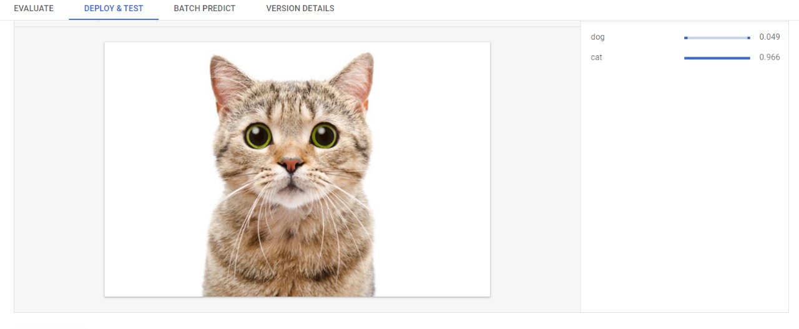
AutoML

Slide 15
Overview of Custom Training
03

Slide 16
Google Cloud Custom Training (Tensorflow)
TensorFlow Custom Training involves building, training, and deploying ML models using the open-source library TensorFlow.
Custom Training provides complete control and flexibility to developers over the machine learning model.
TensorFlow is a highly flexible and customizable framework that allows for more granular control over model architecture and tuning.

Slide 17
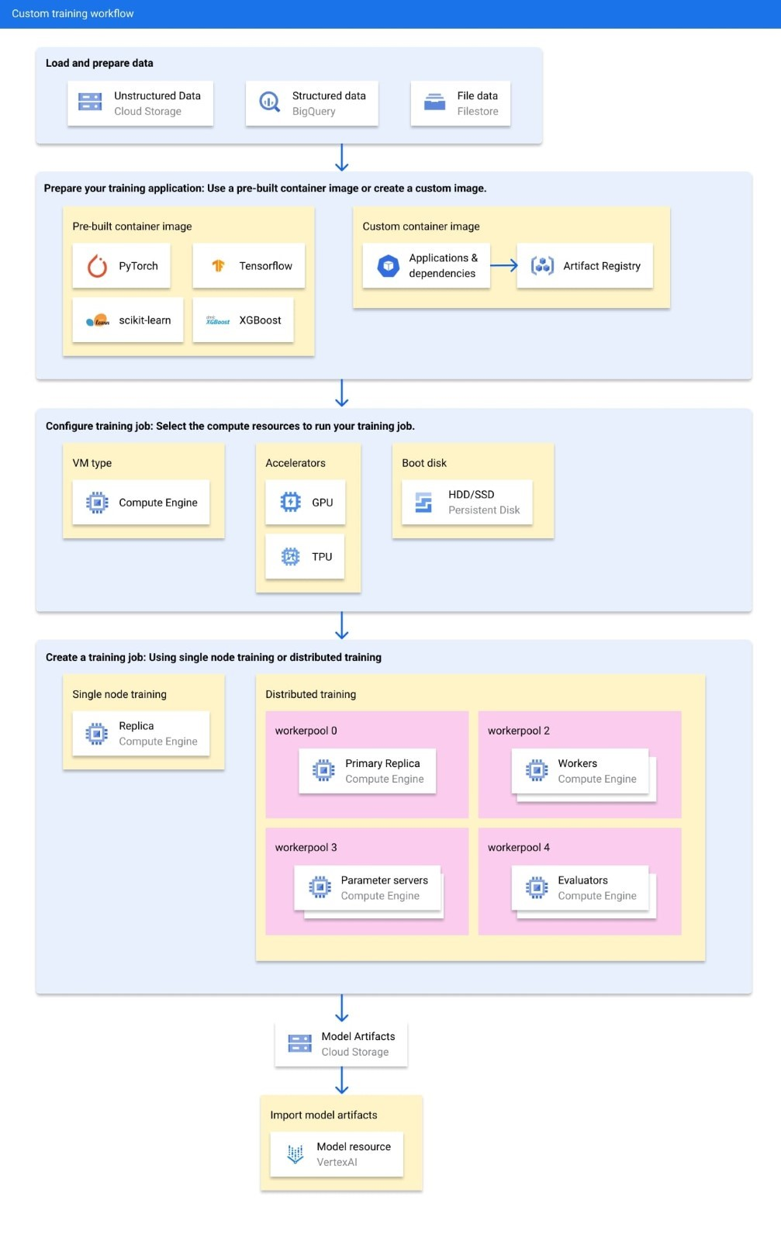

Slide 19
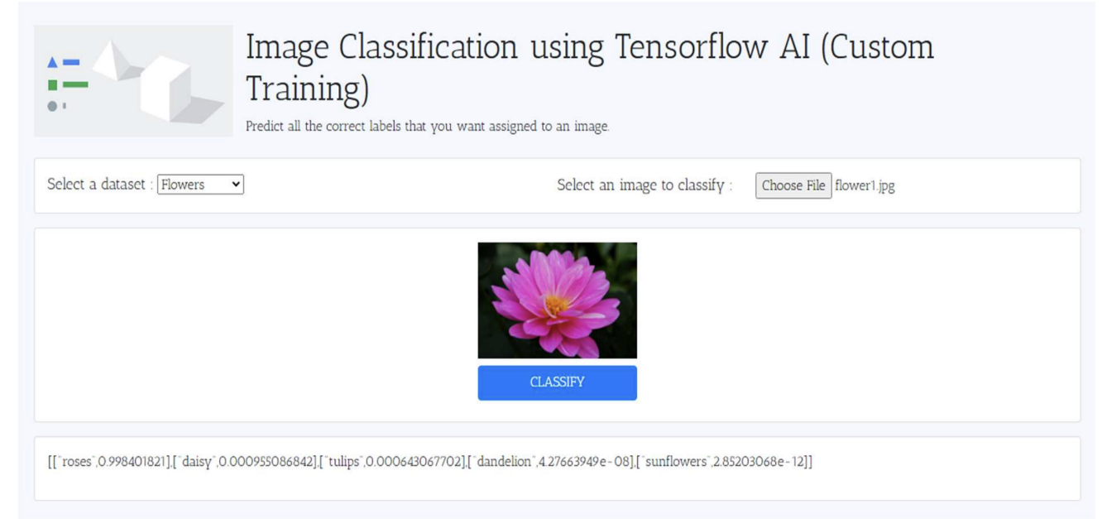
Custom Training

Slide 20
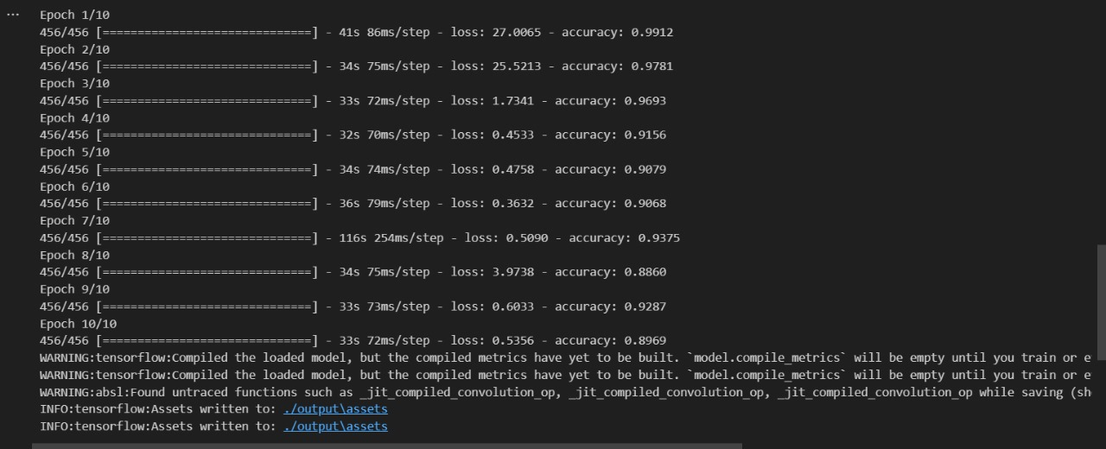

Slide 21
Comparison of AutoML and Custom Training
04

Slide 22
AutoML
User-friendly interface
Without requiring advanced coding skills or prior knowledge of machine learning
Faster and simpler, but may not allow for as much customization as Custom Training
Best option for limited resources and expertise

Slide 23
Custom Training
Greater flexibility and control
Requires more coding knowledge and time investment
Greater control and flexibility
Better choice for those with more resources and a need for greater customization
Both AutoML and Custom Training can achieve high accuracy with proper attention to pre-processing, neural architecture, optimization and best practices

Slide 24
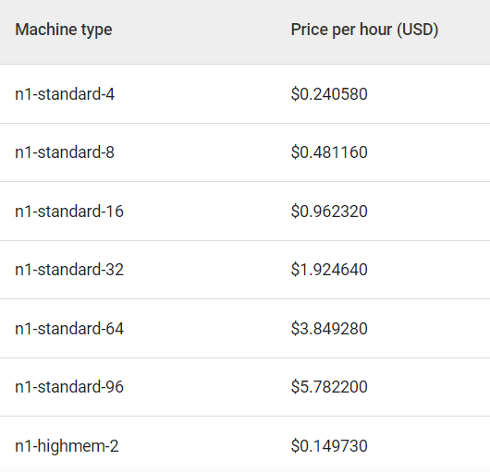
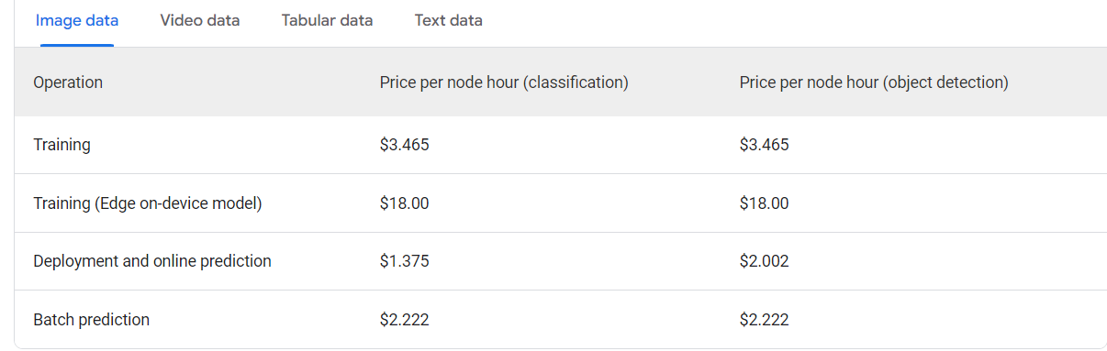
Pricing
Custom Training
AutoML

Slide 25
Conclusion
05

Slide 26
Conclusion
The choice between AuoML and Custom Training ultimately depends on the specific needs and resourced of the project
For those with limited resources and expertise, AutoML may be the best option
For those with more resources and a need for greater customization, Custom Training may be the better choice
Custom Training may easy fail when not having sufficient knowledge

Slide 27
Prototype
06

Slide 28
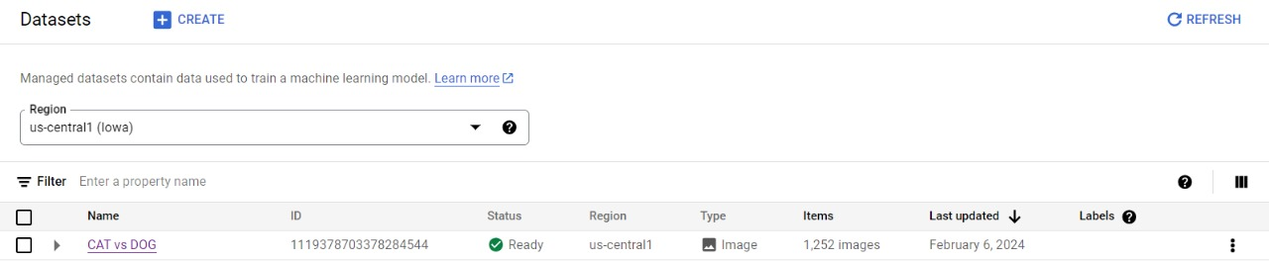

Slide 29
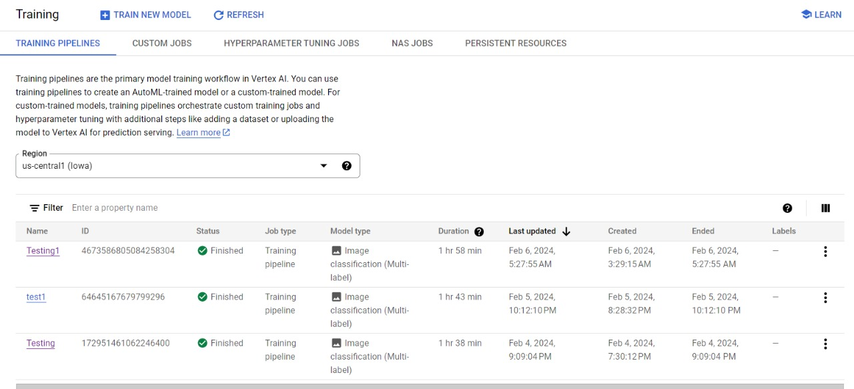

Slide 30
